Slide 1
Hash Functions Topic 6 Discussion 2
Ryan Coon

Slide 2
Mid-Square

Slide 3
Mid-Square hashing is a hashing technique in which unique keys are generated. In this technique, a seed value is taken and it is squared. Then, some digits from the middle are extracted. These extracted digits form a number which is taken as the new seed. This technique can generate keys with high randomness if a big enough seed value is taken. However, it has a limitation. As the seed is squared, if a 6-digit number is taken, then the square will have 12-digits. This exceeds the range of int data type. So, overflow must be taken care of. In case of overflow, use long long int data type or use string as multiplication if overflow still occurs. The chances of a collision in mid-square hashing are low, not obsolete. So, in the chances, if a collision occurs, it is handled using some hash map.

Slide 4
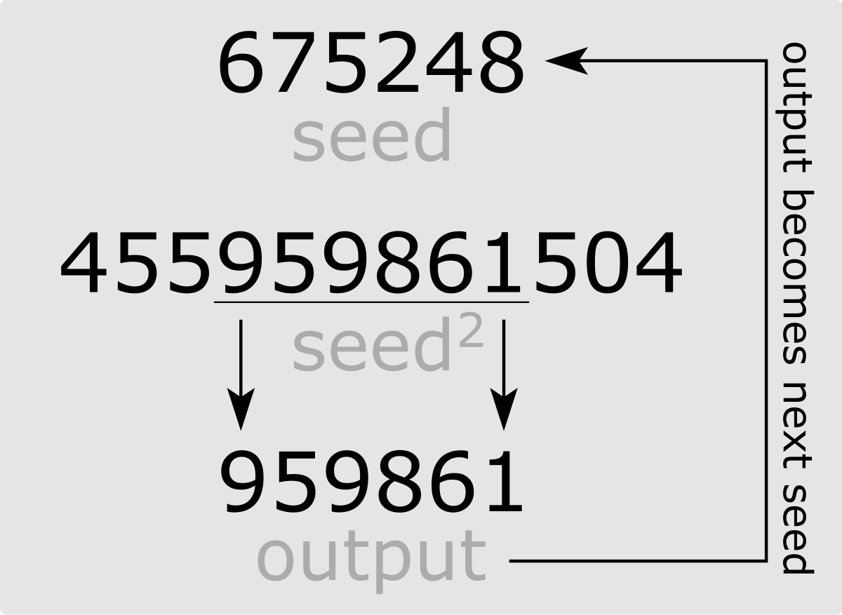

Slide 5
Extraction

Slide 6
Using digit extraction a key is assigned a location based on the digits that we have extracted from it.
For example lets say we select the 1st, 3rd, and 5th digits from the right side and use them as address.
123456
2 4 6
We mod the extracted digits by their number of location if the extracted digits do not fit the size of the location assigned to them.
Example:
For a student record with Id = 000923456, we can take the last four digit and store it in record number 92456.

Slide 7
Radix Transformation

Slide 8
In the radix transformation method, the key is transformed into another numeric base. For example, if our key is 23 in base 10, we might convert it to 32 in base 7. We then use the division method and divide the converted key by the table size and use the remainder as our index. Continuing the previous example, if our table size is 17, we would compute the function:
HashCode(23) = Math.abs(32) % 17 = 15

